Slide 1
IE 500: STATISTICAL MACHINE LEARNING
CUSTOMER CHURN PREDICTION AND ANALYSIS IN TELECOMMUNICATION
By:
Awnish Shankar 50542202

Slide 2

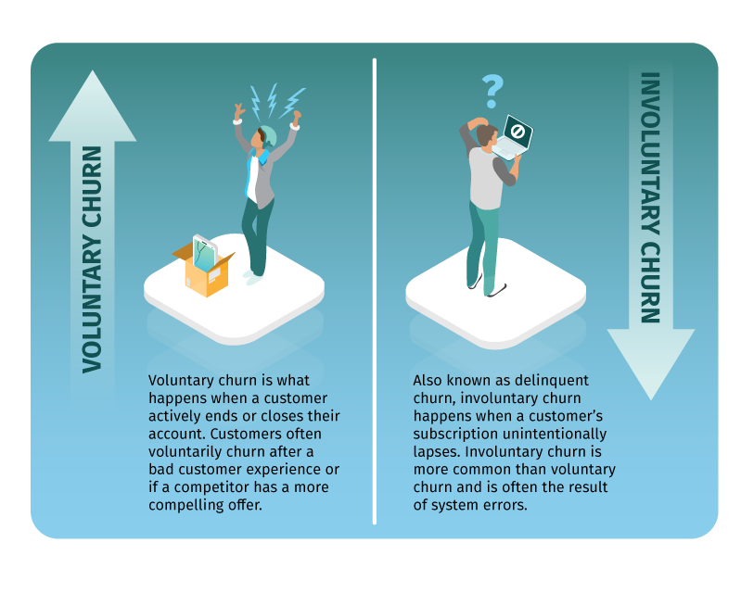
Introduction
Customer churn is the rate at which customers stop using your company's product or service during a certain time frame.
In some countries, the cost of customer acquisitions could be as high as 20 times the cost of customer retention. By:- National University of Sciences and Technology, Pakistan.

Slide 3
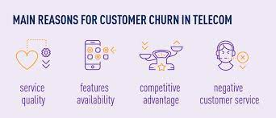
Size of the Problem
Figures From the Year 2022
400 M subscribers in the U.S. telecommunications industry for different Services.
Churn rate was 1.9% across the top four carriers (AT&T, Verizon, T-Mobile, Sprint).
The cost of new customer acquisition per carrier was $10.39 B.
The yearly loss due to customer churn per carrier was just $780 M which is approx. 1/13th the cost of the customer acquisition.

Slide 4
Objective of the study
The study aims to address the works in the domain of customer churn in telecommunication and propose and apply different ideologies to further elevate the predictive performance.
To identify the relative importance of different variables, and how telecom companies can optimize resources, focusing efforts on these variables that have a significant impact on reducing customer churn.
To propose applications of other significant models for further enhance predictive accuracy and to draw actionable insights into customer relationship management.

Slide 5
Data Introduction
The dataset is taken from a project on Kaggle which claims to have used the IBM Sample dataset.
The dataset has 7043 observations and 21 variables. Out of 21, 3 are numerical, and 18 are categorical variables.
Variables:
Services that each customer has signed up for – phone, multiple lines, internet, online security, online backup, device protection, tech support, and streaming TV and movies.
Customer account information – how long they’ve been a customer, contract, payment method, paperless billing, monthly charges, and total charges.
Demographic info about customers – gender, age range, and if they have partners and dependents.

Slide 6
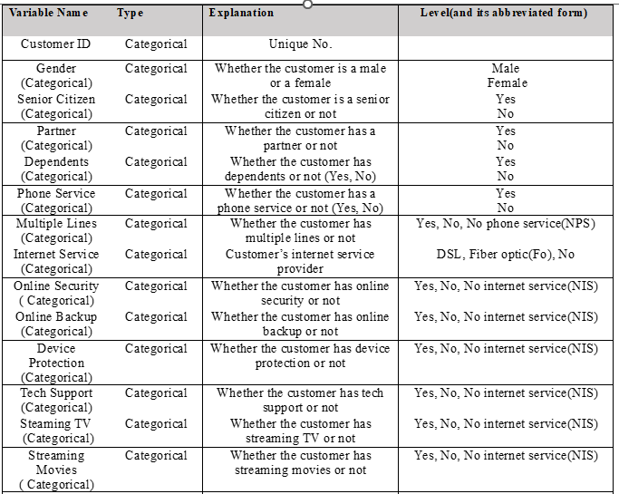

Slide 7
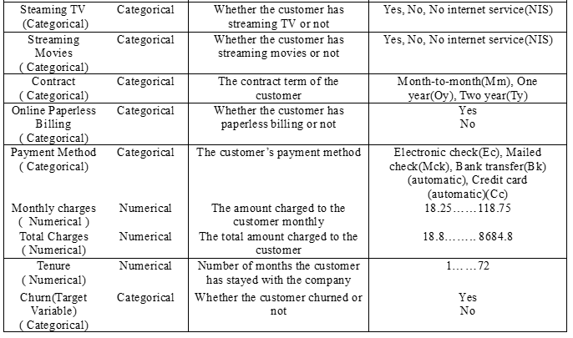

Slide 8
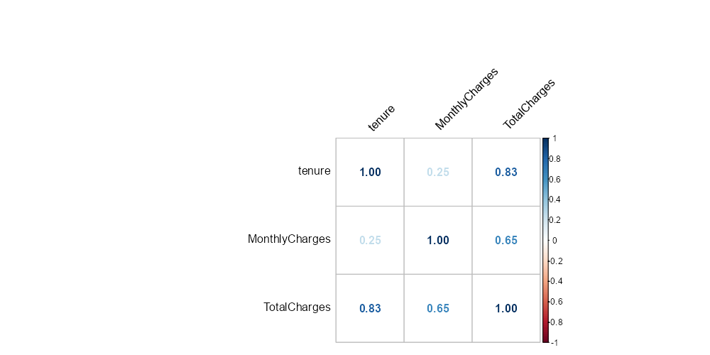
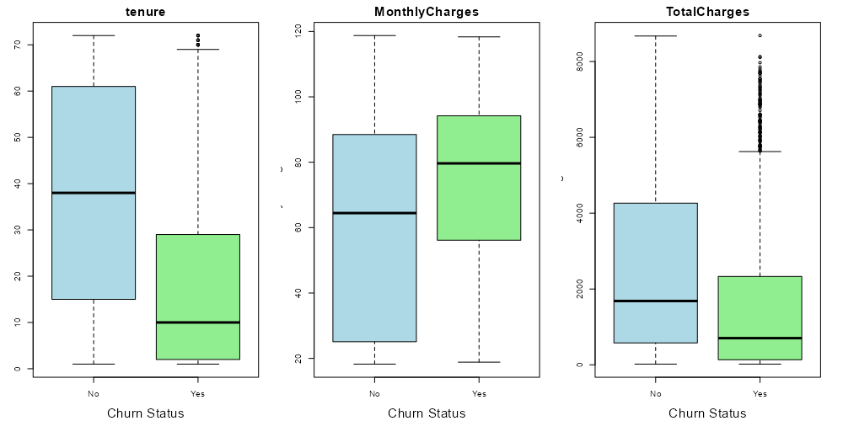
Data Exploratory Analysis

Slide 9
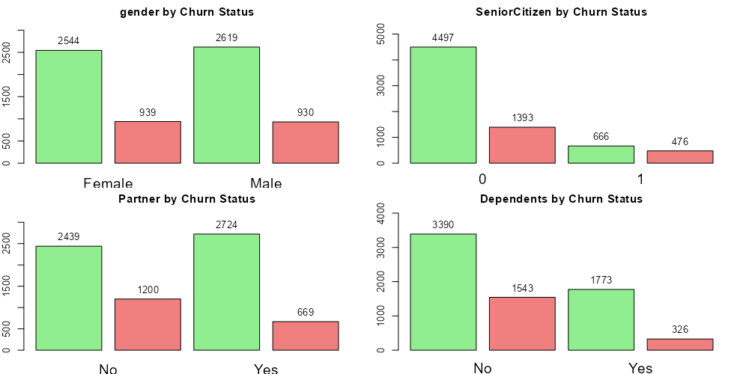
Data Exploratory Analysis
Churn
Non-Churn

Slide 10
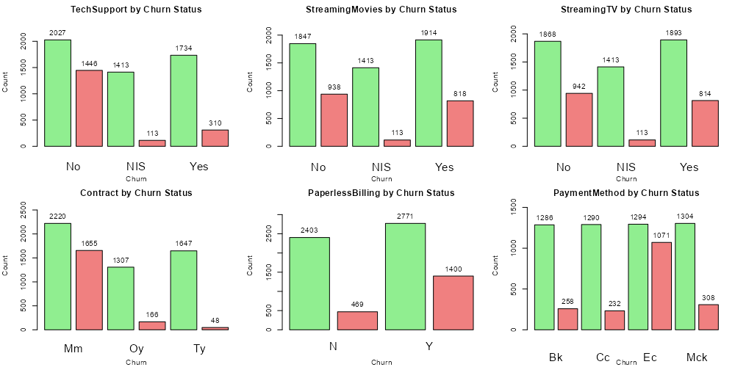
Data Exploration Analysis

Slide 11
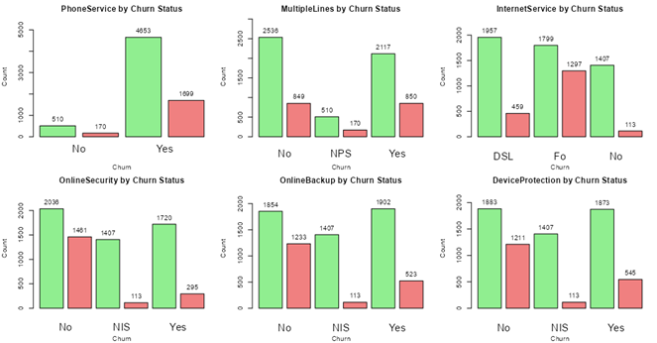
Data Exploration Analysis

Slide 12
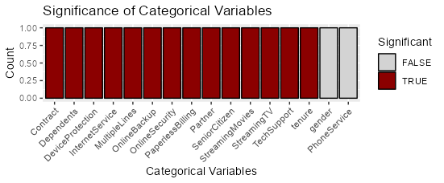
Identifying Significant variables

Slide 13
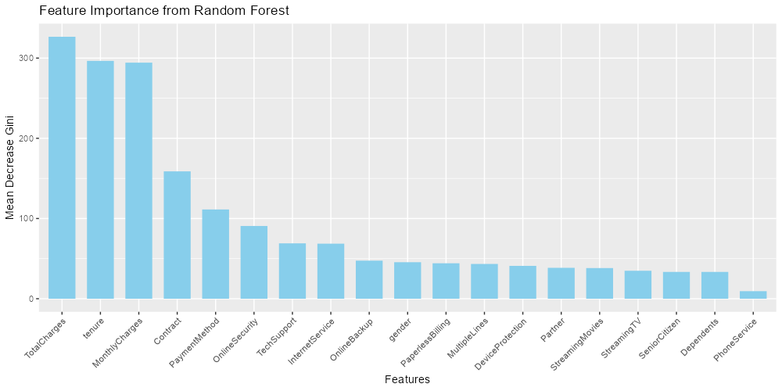
Data Exploration

Slide 14
Models Performance Evaluation
Model | Accuracy(%)
Gradient Boosting | 80.02
Logistic regression | 80
Random forest | 79.1
Decision Tree | 78.9
Naïve Bayes | 66.5
Dataset Split: 75% Train data and 25% Test data.
All the models are trained and evaluated on a train-set using 5-fold cross-validation.
For all the models, the variables gender and tenure are dropped as per the chi-square test.
Logistic regression.
To address the collinearity, the highly correlated categorical variables such as streaming TV, online backup up, and device protection.
For numerical variables, Tenure was found to be substantially correlated with Total charges. The model was tested with and without tenure and found to have a 0.05 % increase in accuracy.
Notes:
Finding key features is crucial for effective data modelling. Feature selection involves evaluating variables based on their relevance to the target outcome. This process enhances model interpretability, reduces dimensionality, and mitigates overfitting, leading to more accurate and efficient predictive models in various domains, including healthcare and finance. To achieve this, we have used the best subset method systematically evaluates all combinations of predictors to find the most predictive subset for a model. It selects the subset with the highest model performance, aiding in feature selection and optimising model complexity, particularly in situations with a moderate number of predictors and

Slide 15
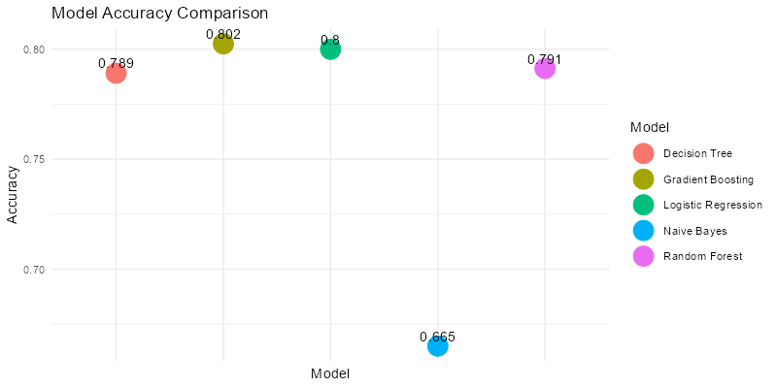
Models Accuracy
Notes:
We are currently targeting three models for our dataset:
The reason behind this is logistic regression has its widespread application in binary classification, offering clear interpretability and estimating odds ratios. It oversees both continuous and categorical variables.
Decision trees, with their simplicity and intuitive graphical representation, aid in understanding decision logic and key influencing factors.
Random forest, chosen for its robustness, noisy data handling, addressing imbalances and providing variable importance measures for categorical variables. Their adaptability of handling diverse data types, and ease of modification contribute to our modelling strategy for predicting heart failure.
The model selection done by using bootstrapping. For smaller datasets, bootstrapping is preferable over K-fold cross-validation or LOOCV as it creates surrogacy validation sets by resampling data with replacement. As a result, a more reliable assessment of the model's performance can be achieved thereby making the most of the available data. On the other hand, because of the decreased sample size in each fold, K-fold cross-validation may lead to a significant loss of information as we will be holding out one of the fold each time. The results after performing bootstrapping (for number of bootstraps=10,000) got the accuracy result as follows

Slide 16
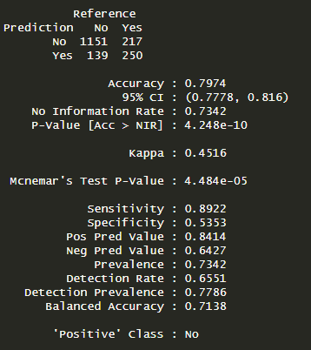
Final Model
Logistic Regression
Accuracy: 79.74 %
Reason:
Even though the gradient boost has higher accuracy on the train set, the increase is very marginal as compared to Logistic Regression.
Given the emphasis on customer retention in the telecommunications industry, logistic regression's straightforward interpretation and the ability to identify significant predictors make it a practical choice for informing strategic decisions in customer relationship management.

Slide 17
Conclusion
Gender and Phone Services are found to be insignificant variables among all the predictors.
Given the type of problem, Logistic regression was found to be the most relevant among all 5 models with an accuracy of 79.74 % on the test set.
Future Work: Want to apply time series analysis, Customer segmentation techniques, and deep learning methods to check if we can further increase the accuracy.

Slide 18
Thank You

